Slide 1
Alfred nobel

Slide 2
alfred nobel
Alfred Nobel was born in 1833 and he died in 1896. Before his death he wrote three wills.
On November 27th,1895 he signed his third and last will. With this will Alfred Nobel caused a lot of controversy both with his relatives and in Sweden because Nobel had left a great part of his wealth for the establishment of the prize.
His family opposed the establishment of the prize. Infact, the first winners were awarded only in 1901.

Slide 3
the will
In his will you can read that his intention was to reward those who in the previous year had “conferred greater benefit to mankind”.
Nobel’s wealth was invested in safe actions that founded the prizes given to the laureates.

Slide 4
nobel prize
The Nobel Prize is divided in 5 parts:
One part to those who have made the most important discovery on Physics.
One part to those who have made the most important discovery on Chemistry.
One part to those who have made the most important discovery on Medicine.
One part to those who have made the most important work of Literature.
One part to those who have made the most important efforts for Peace.

Slide 5
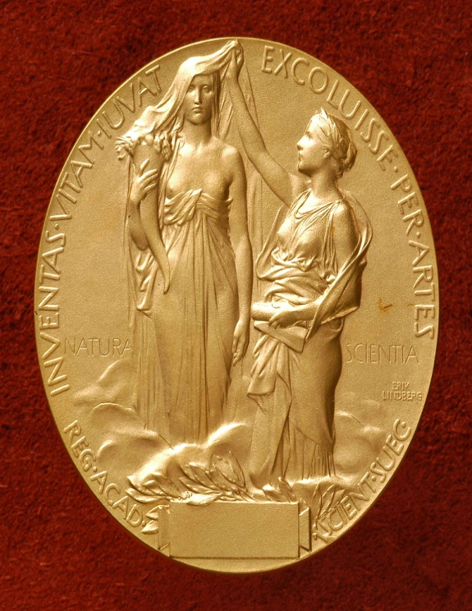
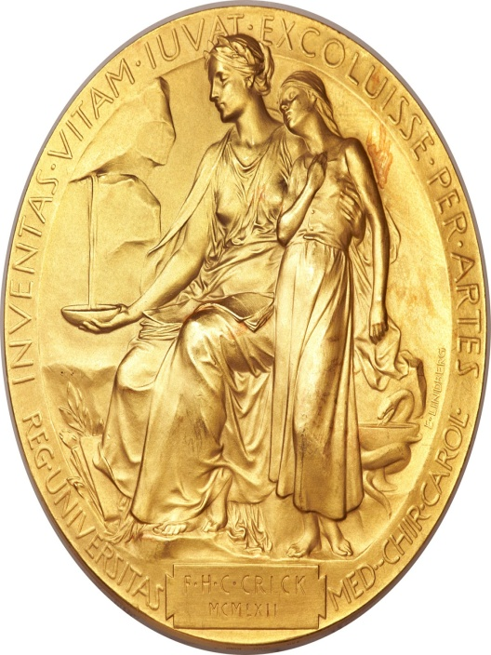
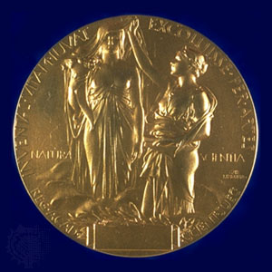
Pysics
Medicine
Chemistry

Slide 6
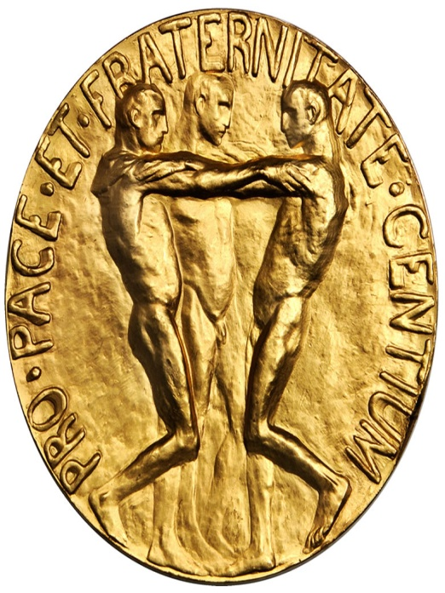
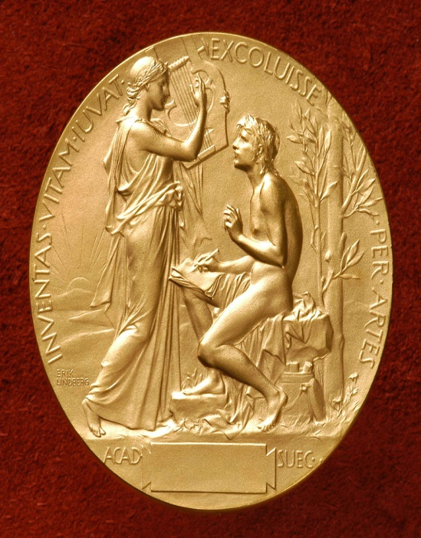
Peace
Literature

Slide 7
Famous people awarded with the Nobel prize

Slide 8
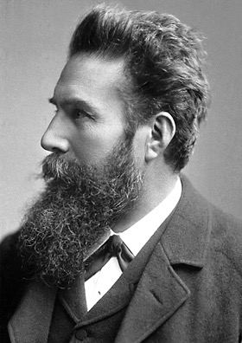
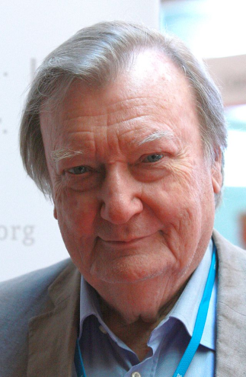
PHYSICS:
In 1901 Wilhelm Conrad Röntgen from Germany won the Nobel Prize for Physics, but his discovery of x-ray was made on the 8th November 1895.
In 1984 the Italian Carlo Rubbia was awarded with the Nobel Prize for Physics for the contribution to the discovery of the particles W and Z.

Slide 9
Chemistry:
In 1963 Giulio Natta from Italy and Karl Ziegler won the Nobel Prize for their discoveries in chemistry and technology of polymers.
Last year Stefan Hell from Romania and the American William Moerner won the Nobel Prize for the development of super resolute microscopes.

Slide 10
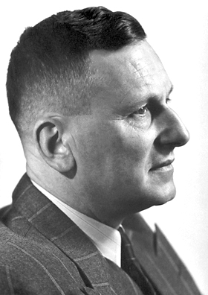
Medicine:
In 1948 the Nobel Prize was won by Paul Hermann Müller for the discovery of the insectcidal DDT.
The Italian Rita Levi-Montalcini won the Nobel in 1986 for the discoveries and growth factors of cells. She died on the 30th of December 2012 at the age of 103.

Slide 11
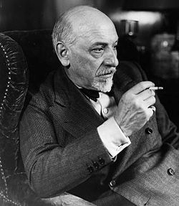
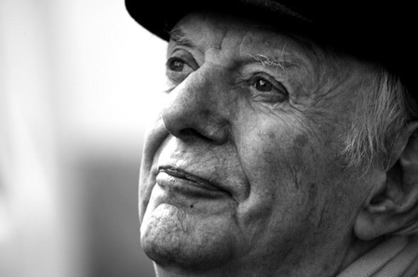
Literature:
The writer Luigi Pirandello in 1934 won the Nobel Prize for his dramatic and theatrical masterpieces.
Dario Fo won the Nobel Prize in 1997. His theatrical works are famous worldwide.

Slide 12
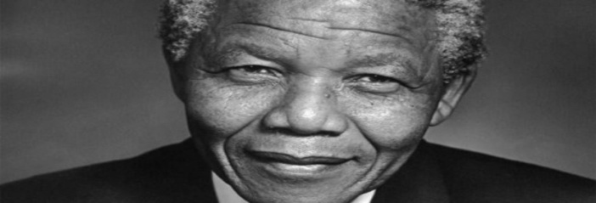
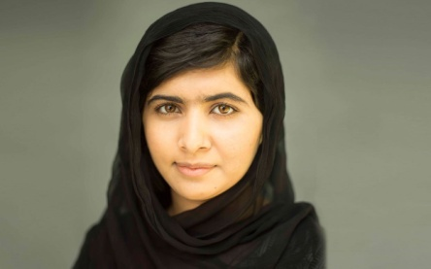
Peace:
The famous Nelson Mandela won the Nobel Prize in 1993. He worked for the peaceful resolution of the apartheid regime and laid the foundations for a new democratic South Africa.
Malala Yousafzai from Pakistan won the Nobel Prize in 2014 for her fight for the rights of all children to education.

Slide 13
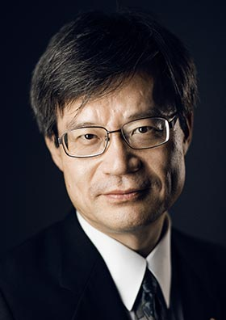
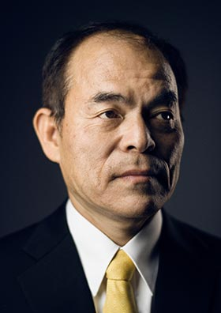
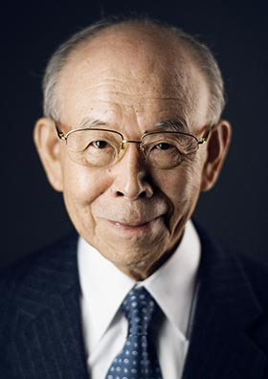
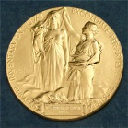
2014 NOBEL PRIZE in PHISYCS
TO:
Iroshi Amano
Shuji Nakamura
Isamu Akasaki
Prize shared 1/3
Prize shared 1/3
Prize shared 1/3

Slide 14
The Nobel Prize in Physics 2014
In 2014 three Japanese citizen (Isamu Akasaki, Hiroshi Amano, Shuji Nakamura) won the Nobel Prize in Physics for the invention of efficient blue light–emitting diodes which has enabled bright and energy-saving light sources.
They won roughly 1.000.000€ to be equally shared.

Slide 15
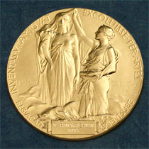
Hiroshi Amano
Japanese citizien.
Born 1960 in Hamamatsu, Japan.
Ph.D 1989 from Nagoya University, Japan
Professor at Nagoya University, Japan

Slide 16
Shuji nakamura
American citizien.
Born 1954 in Ikata, Japan.
Ph.D 1994 from the University Of Tokushima, Japan.
Professor at University of California,Santa Barbara, CA, USA.

Slide 17
Isamu Akasaki
Japanese citizien.
Born 1929 in Chiran, Japan.
Ph.D 1964 from Nagoya University, Japan.
Professor at Meijo University, Nagoya.
Distinguished Professor at Nagoya University Japan.

Slide 18
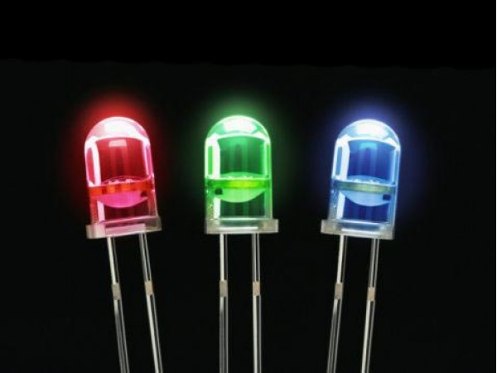
New eco-light to illuminate the world
L.E.D. (LIGHT EMMITING DIODE)
Eco friendly
Energy-efficient
Long-lasting
Cheap
Bright

Slide 19
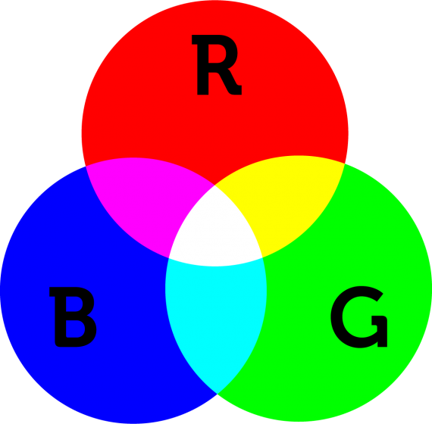
White L.E.D.
RED and GREEN diodes had been around for a long time but without BLUE light, the WHITE lamps could not be created.
RED + GREEN + BLUE = WHITE

Slide 20
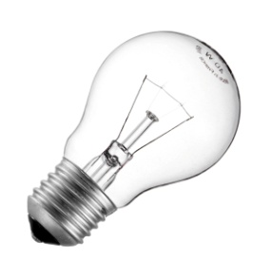
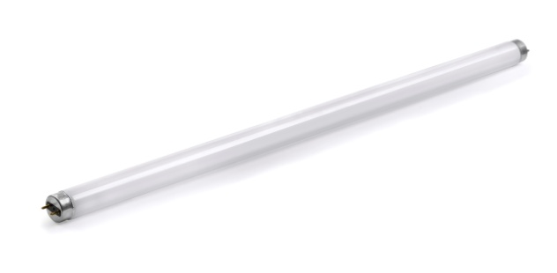
Electricity consumption and Material consumption
1)LEDs last up to 100.000 hours.
Incandescent bulbs last up to 1.000 hours
Fluorescent lights last up to 10.000 hours
2)LEDs can be powered by local solar power.
The 21th century will be lit by led lamps.

Slide 21
ROME'S FOUNDATION ANNIVERSARY
In Italian “Natale di Roma” is the anniversary of the foundation of Rome. According to the legend Rome wad founded by Romulus on April 21th in the year 753 a.C.
This event is important because in the latest edition Vittorio Storaro , Oscar winner, with the help of his daughter, Francesca Storaro, lit the entire “Imperial Forums” using approximately 300 LEDs creating a spectacular and breathtaking atmosphere.

Slide 22
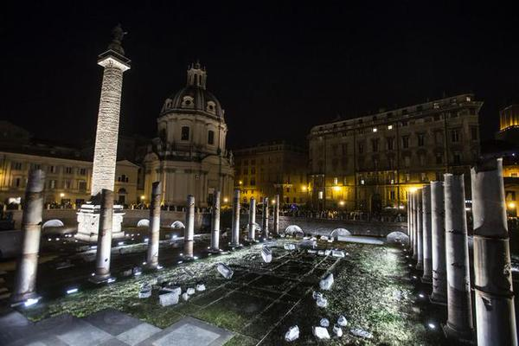
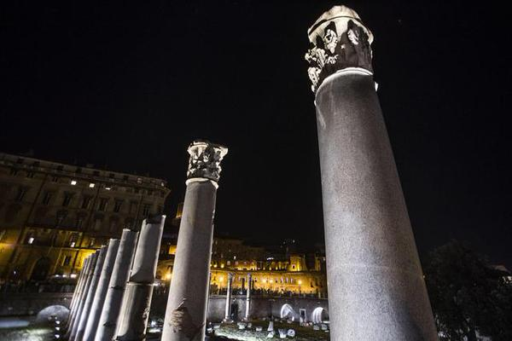
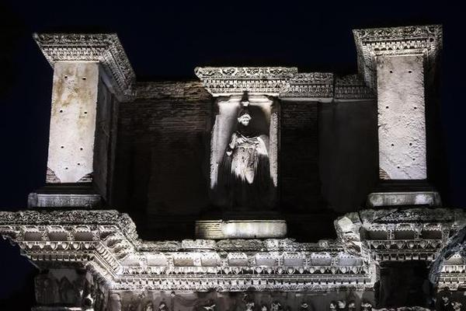
Here are some pics:
Foro Di traiano
Temple of Marte Ultore
Foro Di Augusto

Slide 23
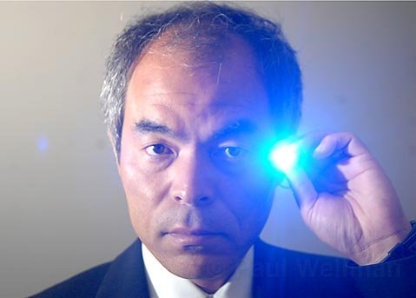
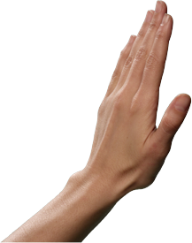
Interview with Shuji Nakamura
Where were you when you heard the news?
What was your initial reaction on hearing the news?
Did you ever imagine it would become so important?
What gave you the courage to continue and make it happen?
And what advice do you have for students who are just starting out?

Slide 24
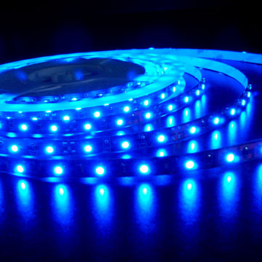
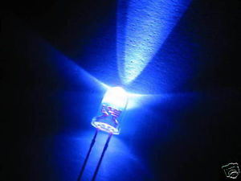
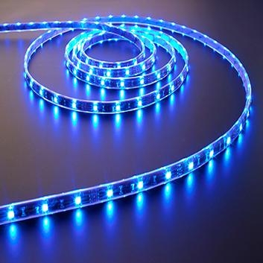
Blue LEDs–Filling the world with new light
With the advent of LED lamps we now have more long-lasting and more efficient alternatives to other light sources. When Akasaki, Amano and Nakamura arrive in Stockholm in early December to attend the Nobel Prize ceremony, they will hardly fail to notice the light from their invention glowing in virtually all the windows of the city. Moreover, and unlike fluorescent lamps, they do not contain mercury.

Slide 25
Red and green led light-emitting diodes have been with us for almost half a century, but blue light was needed to really revolutionize lighting technology. Only the triad red, green and blue can produce the white light that illuminates the world for us. Akasaki worked with Amano at Nagoya University while Nakamura was employed at Nichia Chemicals, a small company.

Slide 26
A light-emitting diode consists of a number of layered semiconductor materials. In the LED, electricity is directly converted into light particles, photons, leading to efficiency gains compared to other light sources where most of the electricity is converted to heat and only a small amount into light. In incandescent bulbs electric current is used to heat a wire filament, making it glow. In fluorescent lamps a gas discharge is produced creating both heat and light.

Slide 27
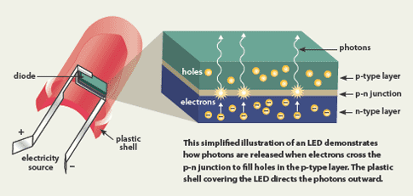
HOW DOES A L.E.D. WORK?
A light-emitting diode consists of several layers:
An n-type layer with a surplus of negative electrons
A p-type layer with an insufficient amount of electrons also called layer with a surplus of positive holes
Between them there is an Active layer , to witch the negative electrons and the positive holes are driven when an electric voltage is applied to the semiconductor

Slide 28
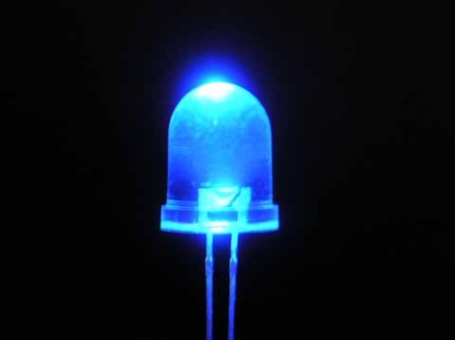
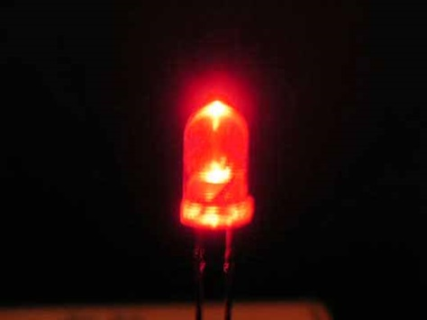
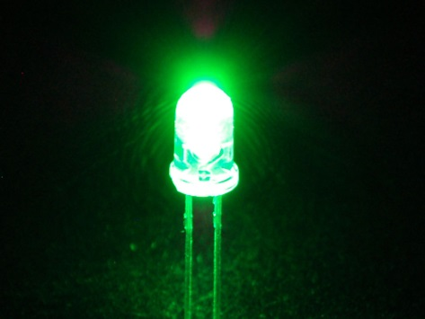
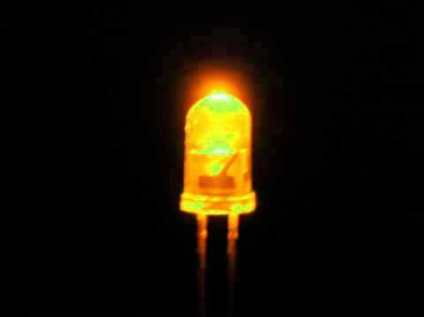
COLORS OF THE L.E.D.s
The colors of the L.E.D.s depends entirely on the semiconducting material used, for example the blue L.E.D consists of several different layers of gallium nitride mixed with indium and alluminium increasing the L.E.D efficiency. Here are some colors:

Slide 29
L.E.D.s Circuit
R
L1
L2
L3
This little circuit was realized with three leds in series and one transformer .
The leds were weld into a breadboard where the alternate current from the socket is transformed into direct current .
In this circuit we have three leds: blue, red and green.
This circuit works because it is powered from the anode to the cathode.

Slide 30
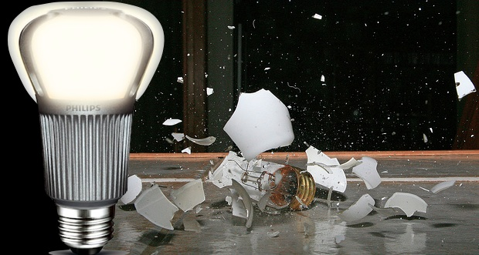
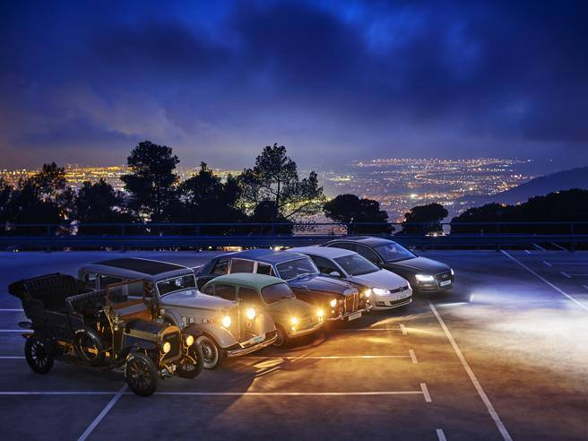
A bright revolution
The laureates’ inventions revolutionized the field of illumination tecnology.
New, more efficient, cheaper and smarter lamps are developed all the time.
Led lamps are thus flexible light surces, already with several applications in the field of illlumination.
The possibility to control the colour of light also implies that led lamps can reproduce the alternations of naural light and follow our biological clock.
The invention of the efficient blue led is just twenty years old, but it has already contributed to creating white light in an entirely new manner to the benefit of us all.

